Slide 1
AI - Anarchy or Abundance: Why The Future of Work Needs Pro-Human Leaders
Rob Garlick

Slide 2
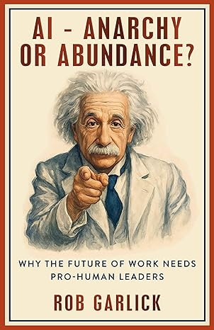
AI workers will outnumber human workers within two decades—transforming work faster than societies are ready for.

Slide 3

Enacting solutions so AI benefits most is not a technology question; it's a leadership question.
The natural path favours machines and profits, so leaders must balance this with pro-human thinking, not by rejecting AI but by shaping how it's deployed.

Slide 4
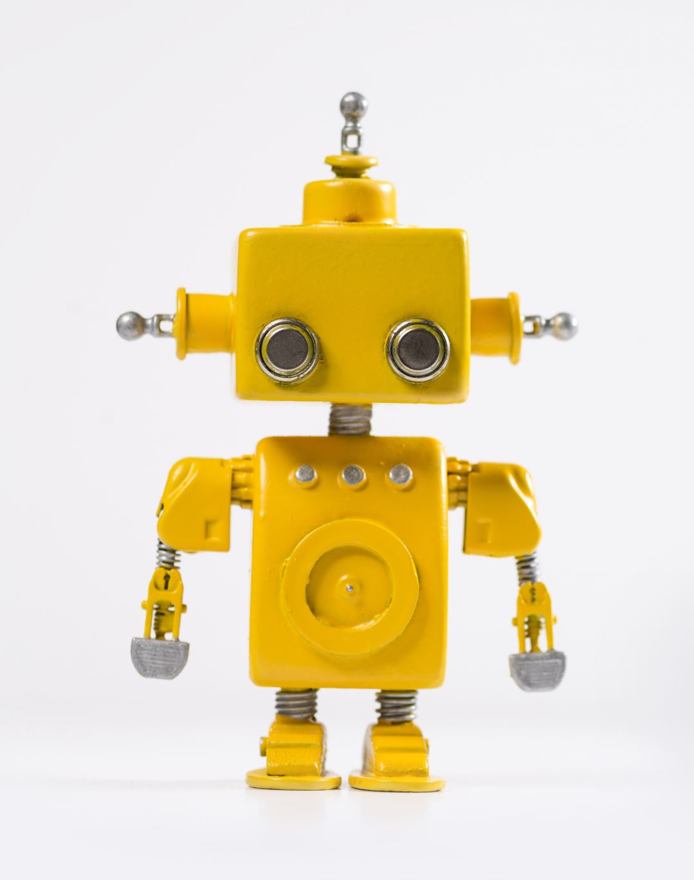
Currently Robots are less than 1% of human population, prediction of book is that robots will out- number human workers by 2 decades

Slide 5

Example McKinsey
Current workforce, 40,000 people
18 months ago, they had 3000 agents
Today 20,000 agents
Presictict in 18 months will have 40,000 agents

Slide 6

Issues
Workers worried about their jobs. CEOs, board members juggling investor expectations and employee anxiety.
Politicians trying to keep economies competitive without breaking the social contract.

Slide 7
If you are responsible for people, you are already pulled in two directions: the promise of productivity versus anxiety about what happens when non-human workers scale faster than our safety nets. This book focuses on that tension and what we can do about it.
The stakes are stark. Data is becoming more valuable than people. Capital wins; workers lose. Unmanaged, we face collapsing incomes, shrinking tax bases, and social upheaval, an economic singularity.
But book is about solutions—what to ask of leaders as they invest in AI and how to make the right choices so AI's upsides exceed the downsides. Anarchy, "without leadership," is the opposite of what this moment requires.

